Slide 1
NETWORK OPERATIONS
ACTIVITY
Telecom Network Analytics
NETWORK VIEW
From raw mobile activity to an operational intelligence control room.
GRID COVERAGE
10,000
DATA ENGINEERING
FASTAPI
REACT NOC
MACHINE LEARNING
CLAUDE READY
ALERTS
OPERATIONAL
RISK
Customer / Team Lead Presentation
PREDICTIVE
A production-minded analytics journey with operational visibility, predictive risk and explainable evidence.
NEXUS / TELECOM NETWORK ANALYTICS

Slide 2
01 / VALUE
02
What the platform delivers
A single operational view from network activity to prioritized investigation.
NETWORK VISIBILITY
OPERATIONAL VIEWS
DECISION SIGNALS
AI-READY
10,000
5+
3
Claude
Milan grid cells
Overview, grids, hotspots, alerts, risk
Rules, anomaly baseline, ML risk
Evidence-grounded assistant layer
CUSTOMER OUTCOME
ENGINEERING OUTCOME
▸ Move from raw activity tables to an operator-friendly control room.
▸ Identify where activity is unusual and why it deserves attention.
▸ Connect spatial context, historical behavior and predictive risk.
▸ Keep data quality visible before decisions are made.
▸ Layered architecture with clear responsibility boundaries.
▸ Reusable FastAPI contracts consumed by the React dashboard.
▸ Time-aware ML features and chronological validation.
▸ Designed for safe AI augmentation rather than AI replacing analytics.
NEXUS / TELECOM NETWORK ANALYTICS

Slide 3
02 / CONTEXT
03
The operational problem
Network teams have data — the challenge is turning it into a trustworthy next action.
WITHOUT AN INTEGRATED VIEW
WITH NEXUS
▸ Large hourly activity datasets are difficult to scan manually.
▸ A high value does not automatically mean an operational incident.
▸ Historical context is needed to distinguish recurring peaks from deviations.
▸ Predictive scores need network evidence around them.
▸ If the pipeline is stale or unhealthy, downstream conclusions can mislead.
▸ Start with current KPIs and a shared reporting timestamp.
▸ Drill from a grid to hourly activity and spatial context.
▸ Prioritize hotspots and operational alerts.
▸ Assess future high-activity risk with an explainable baseline model.
▸ Keep evidence, uncertainty and data health visible.
NEXUS / TELECOM NETWORK ANALYTICS

Slide 4







03 / ARCHITECTURE
04
One system, built in layers
Compute, score and reasoning stay separated.
Landing & Raw Zone
PySpark Processing
Analytics Warehouse
Feature & ML Scoring
FastAPI Service Layer
React NOC Dashboard
Claude NOC Copilot
Daily Milan activity CSVs + static grid GeoJSON reference
Clean, standardize, aggregate to grid / hour, enrich with geometry
fact_network_activity, dim_grid, dim_time
Trailing-window features, risk classifier, anomaly baseline
Network, feature, prediction & pipeline-status endpoints
KPIs, grid explorer, Milan map, predictive risk view
Tool use, MCP, headless investigation agent
RESPONSIBILITY BOUNDARY
Spark / SQL compute and prepare evidence • ML scores operational risk • Claude reasons over curated evidence
AI is never asked to reproduce the analytics stack or fabricate values.
NEXUS / TELECOM NETWORK ANALYTICS

Slide 5
04 / DATA ENGINEERING
05
From raw activity to analytics-ready data
The pipeline establishes the data contract every downstream layer relies on.
INGEST
VALIDATE
PROCESS
AGGREGATE
ENRICH
STORE
Daily Milan CSVs
Schema + file scope
PySpark cleaning
Grid × hour
Milan geometry
Parquet + warehouse
KEY DATA-GRAIN CONTRACT
RELIABILITY CONTROLS
▸ Canonical hourly network activity at grid level.
▸ Static Milan grid reference with 10,000 cells.
▸ Shared AS_OF semantics across downstream views.
▸ File-scope protection for Milan inputs.
▸ Validation and reproducible processing.
▸ Pipeline status exposed to operational consumers.
NEXUS / TELECOM NETWORK ANALYTICS

Slide 6
05 / INTELLIGENCE
06
Three complementary decision signals
Rules, historical deviation and ML answer different questions.
RULE-BASED ALERTS
ANOMALY BASELINE
ML3 RISK
What is happening right now?
Is this unusual for this grid and hour?
What is the predicted future risk?
HIGH_ACTIVITY
Historical baseline
Future-window target
ACTIVITY_SPIKE
Deviation score
Decision Tree classifier
ACTIVITY_DROP
High / low direction
Risk score + level
Operational principle: a risk score is an attention signal — not proof of congestion or a network fault.
NEXUS / TELECOM NETWORK ANALYTICS

Slide 7
06 / SERVICE LAYER
07
FastAPI turns analytics into reusable operational contracts
The dashboard consumes stable endpoints instead of embedding analytics logic in the UI.
OPERATIONAL API SURFACE
DESIGN BENEFITS
/network/summary
Top-level KPIs
▸ Clear separation between UI and analytics.
▸ Reusable contracts for future AI tools.
▸ Centralized validation and error handling.
▸ One reporting-time concept across the system.
▸ Supports frontend, testing and future Claude tools.
/network/grid/{id}
Hourly grid activity
/network/hotspots
Ranked high-activity areas
/network/alerts
Operational attention signals
/network/grid/{id}/features
ML feature context
/network/predict-risk
ML3 risk inference
/pipeline/status
Data / pipeline health
/network/grid/{id}/location
Geographic grid context
NEXUS / TELECOM NETWORK ANALYTICS

Slide 8
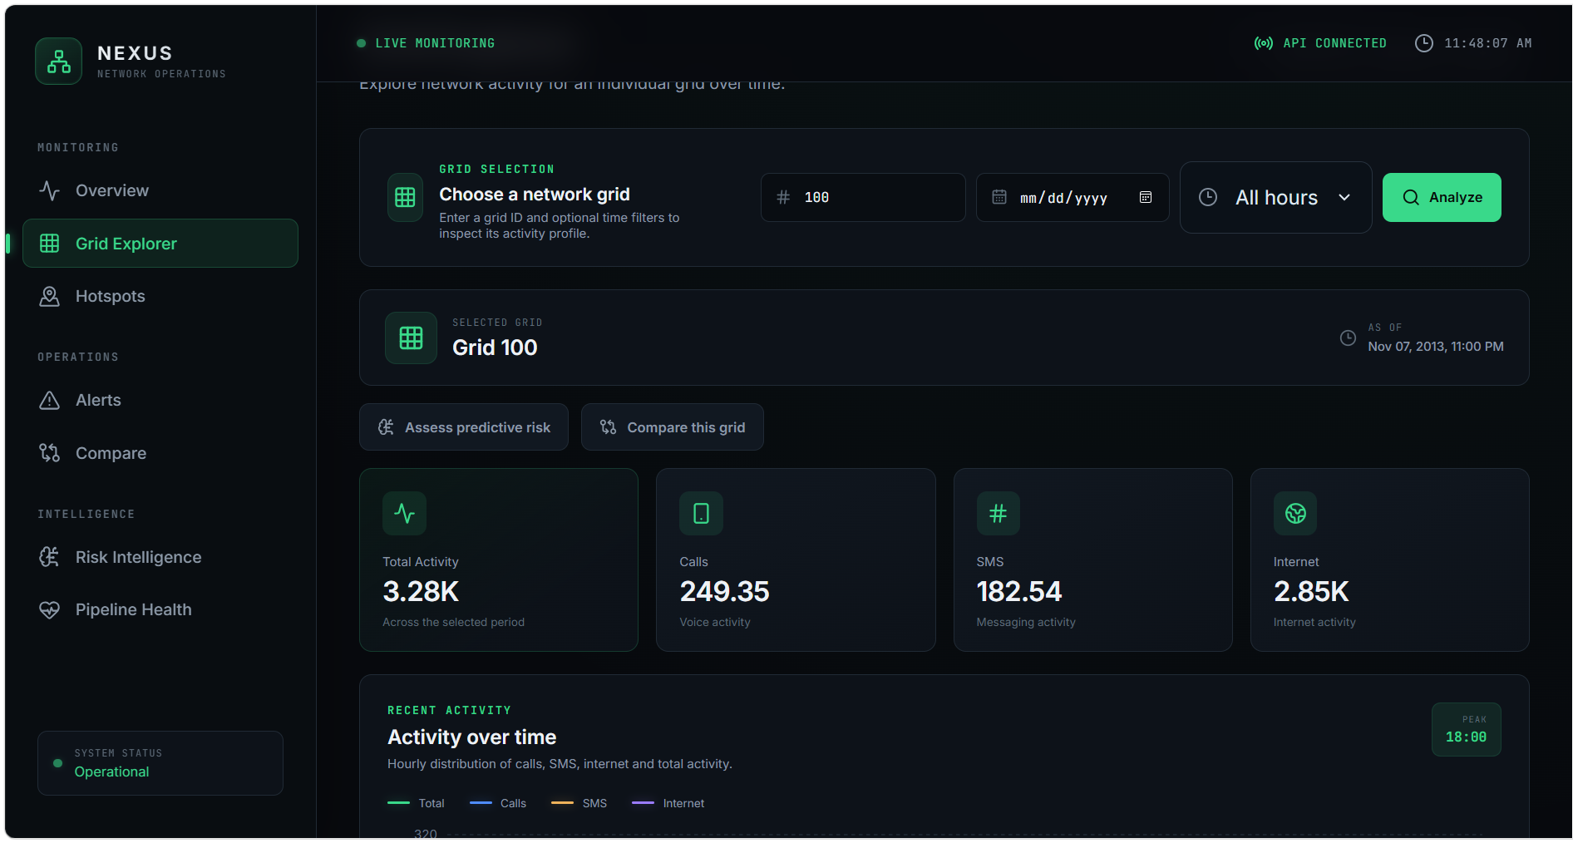
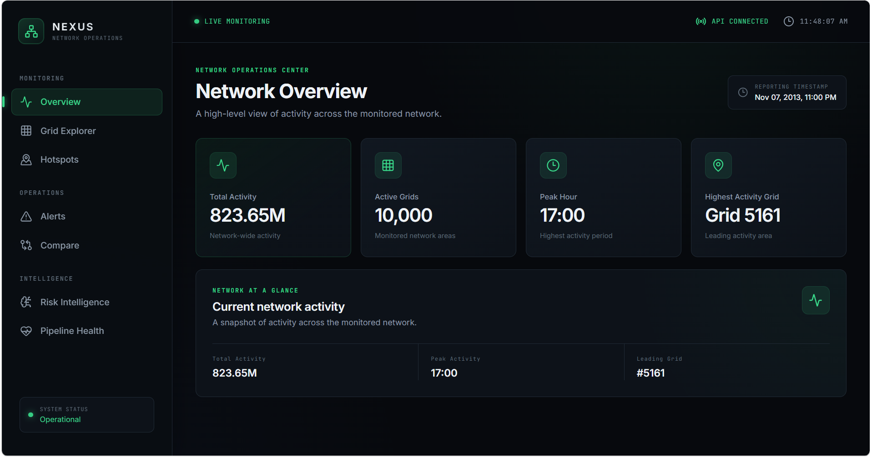
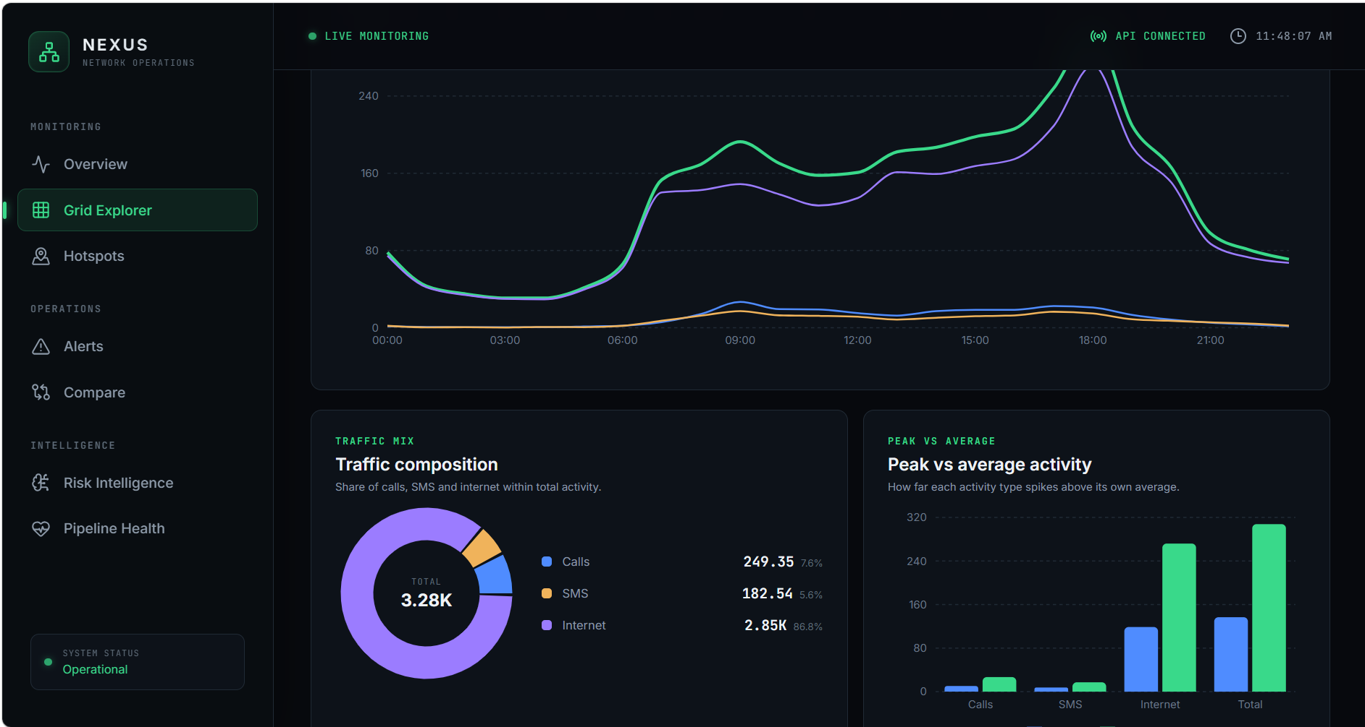
07 / PRODUCT EXPERIENCE
08
The NOC control room
The frontend is intentionally aligned to an operator workflow: orient → drill down → investigate.
Network Overview
Grid Explorer
Overview answers “what is happening?” • Grid Explorer answers “what is happening inside this grid?”
NEXUS / TELECOM NETWORK ANALYTICS

Slide 9
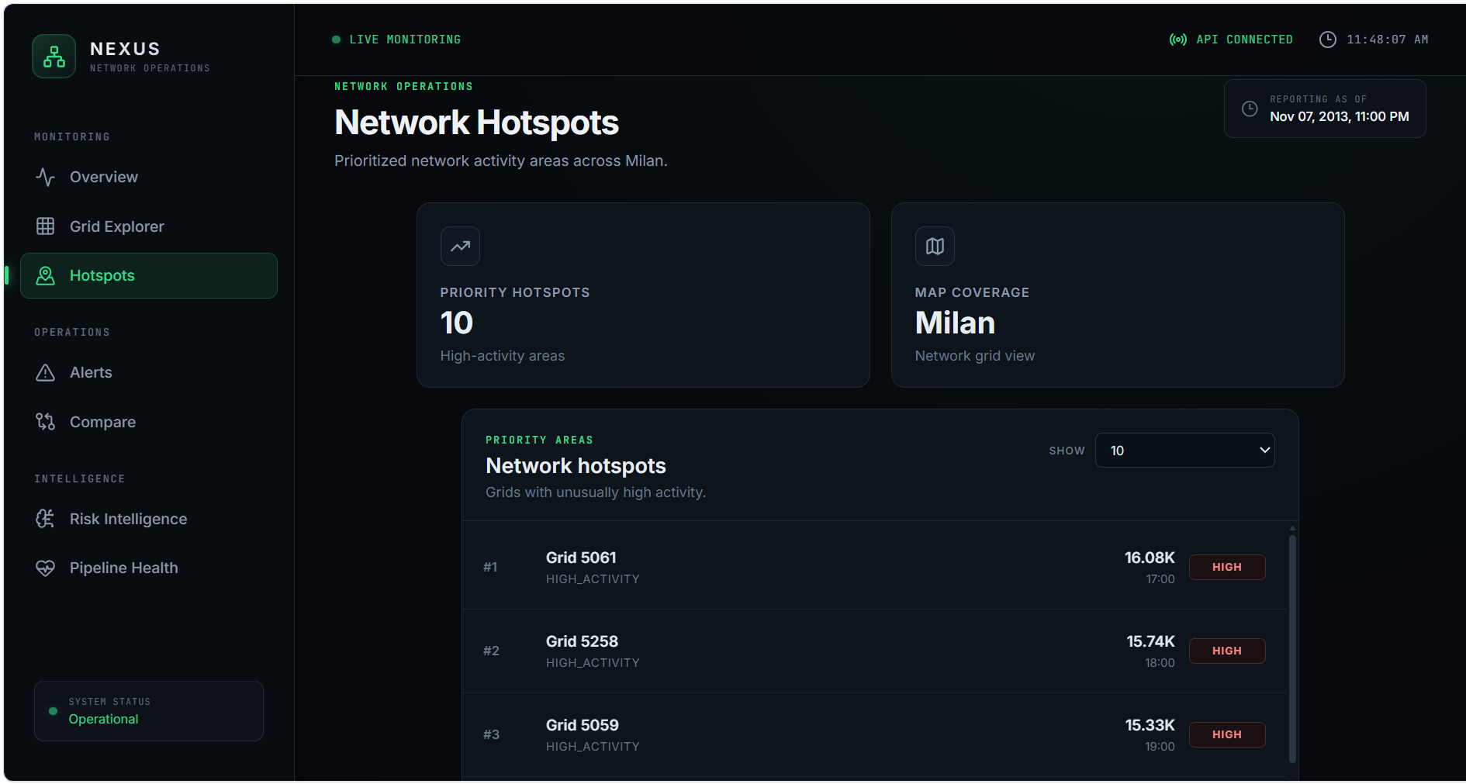
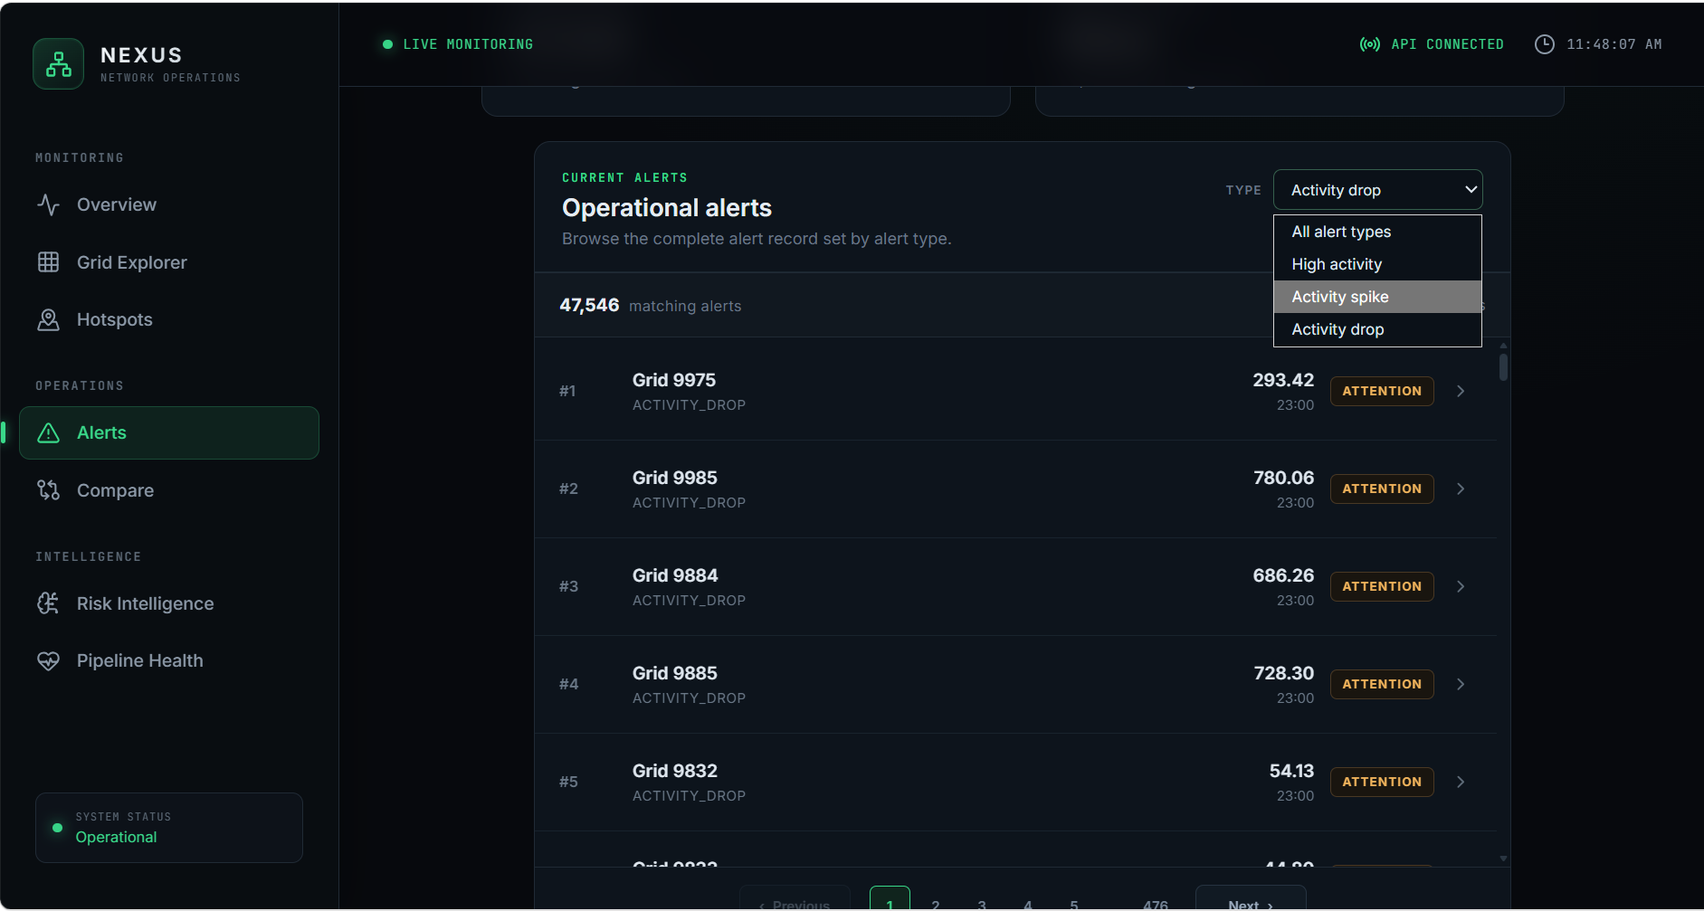
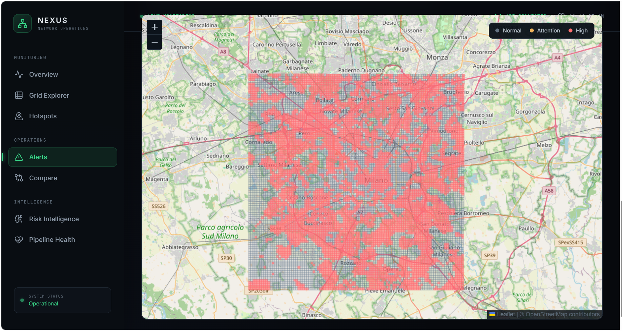
08 / SPATIAL OPERATIONS
09
See the network where it matters
Ranked records and Milan grid geometry turn abstract activity into location-aware operations.
Network Hotspots
Network Alerts
Milan map
NORMAL • ATTENTION • HIGH | independent result limits | grid selection + tooltip context
NEXUS / TELECOM NETWORK ANALYTICS

Slide 10
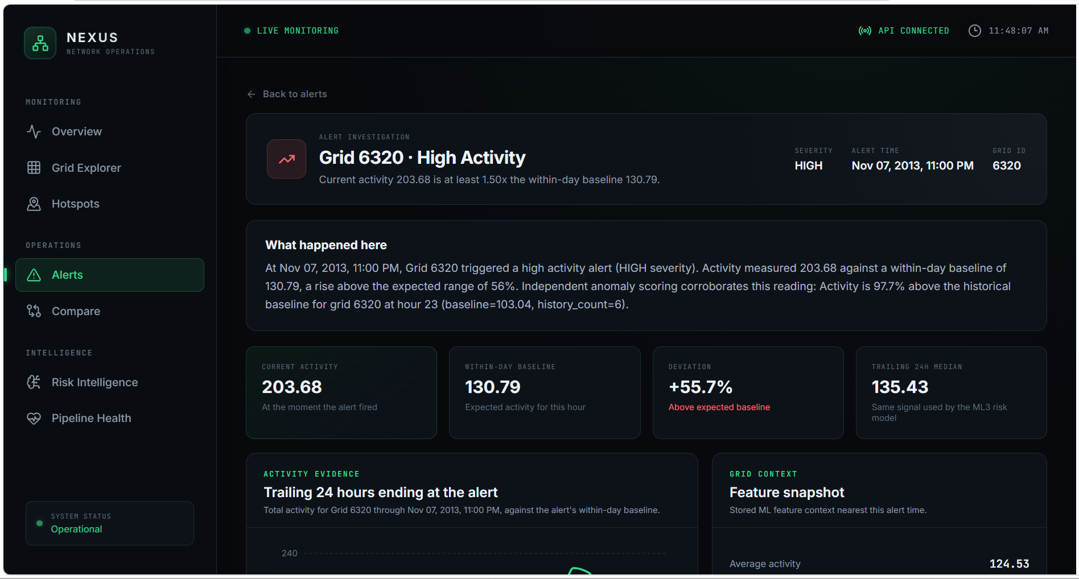
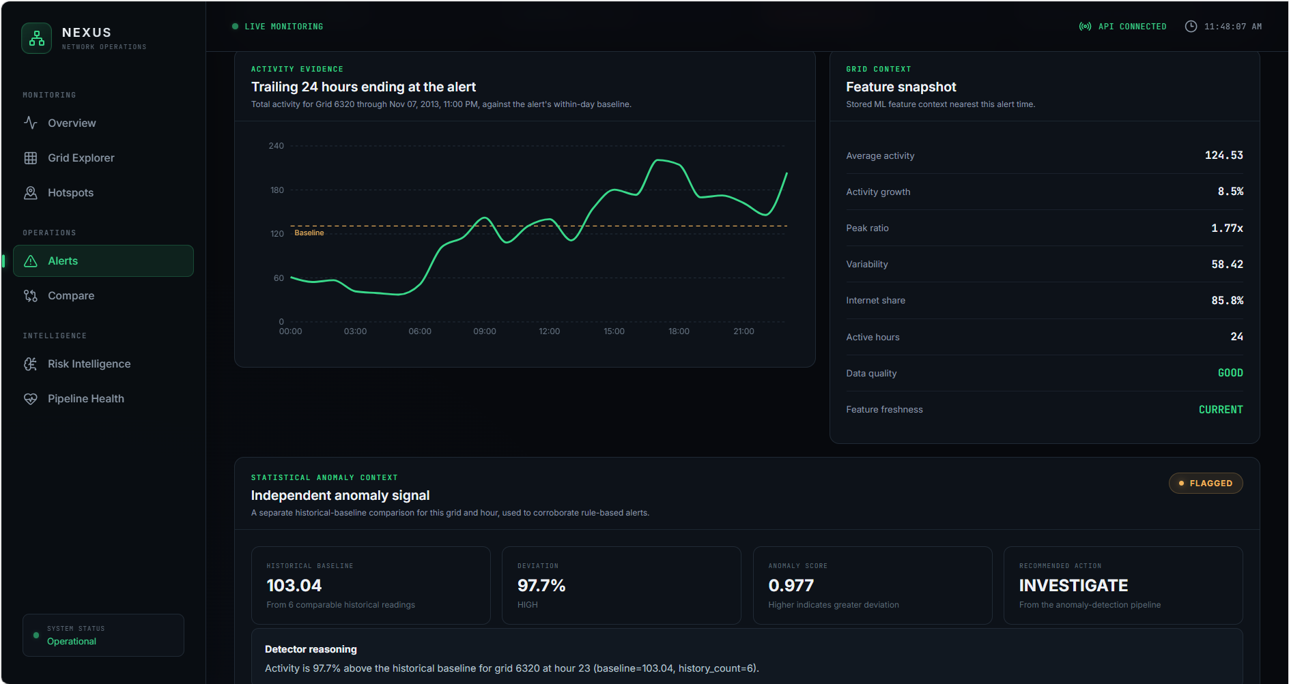
09 / INVESTIGATION
10
Move from alert to evidence
The investigation experience connects the alert record to historical context and comparative evidence.
Alert Investigation / Detail
Analytics / additional operational view
Signal → context → evidence → next action
NEXUS / TELECOM NETWORK ANALYTICS

Slide 11
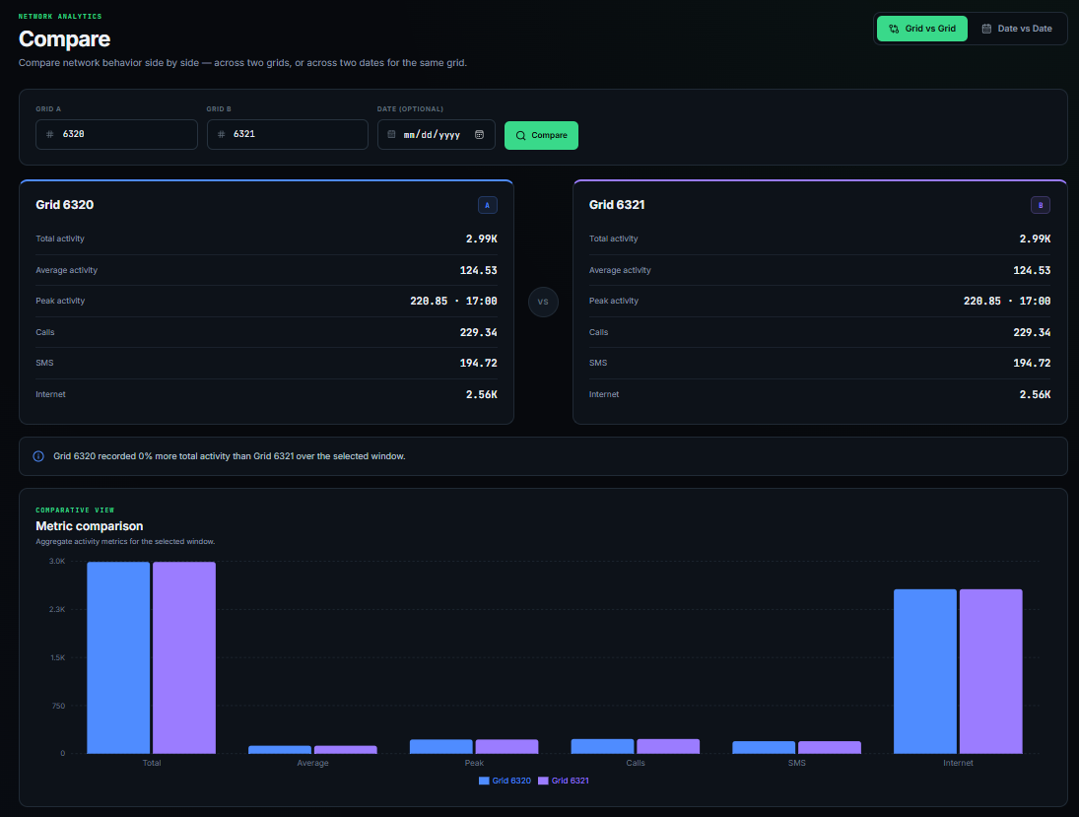
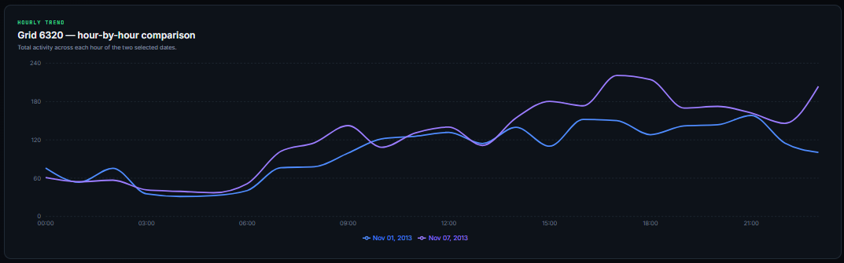
10 / COMPARATIVE ANALYTICS
11
Compare patterns, not just values
Historical and side-by-side views help distinguish isolated spikes from persistent or structural differences.
DECISION QUESTIONS
▸ Is Grid A behaving differently from Grid B?
▸ Is the change persistent across time?
▸ Is the peak expected for this hour?
▸ Does the operational signal agree with the ML risk signal?
Compare mode
NEXUS / TELECOM NETWORK ANALYTICS

Slide 12
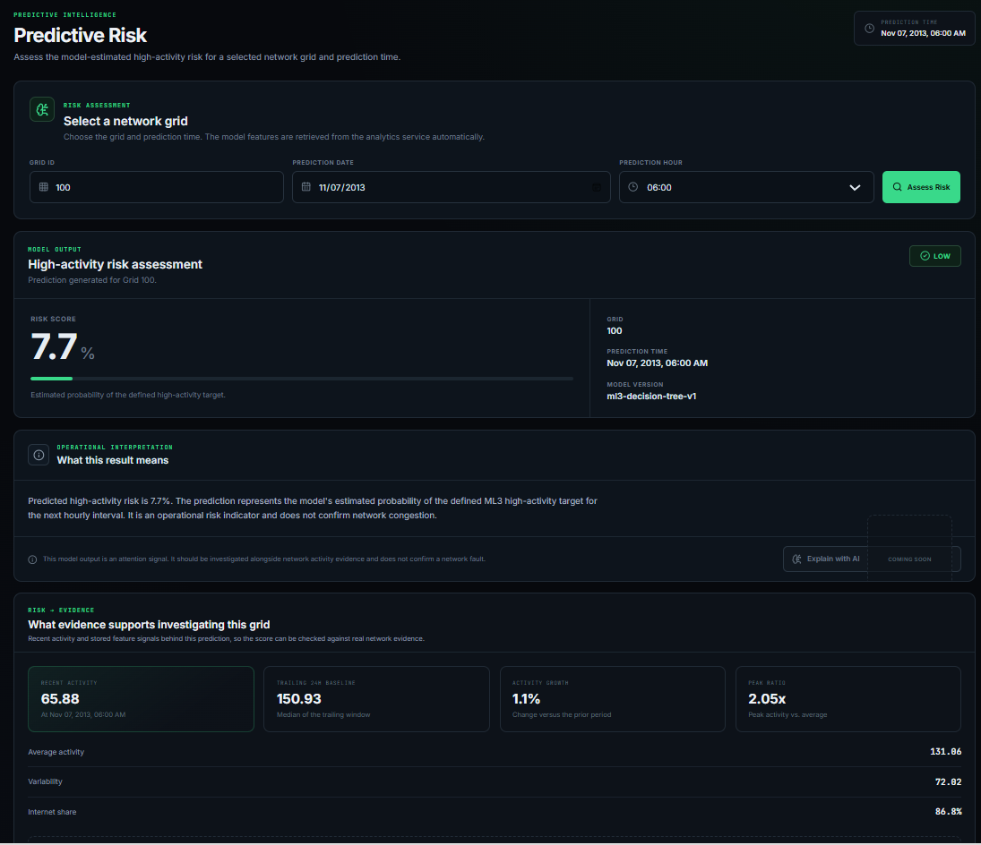
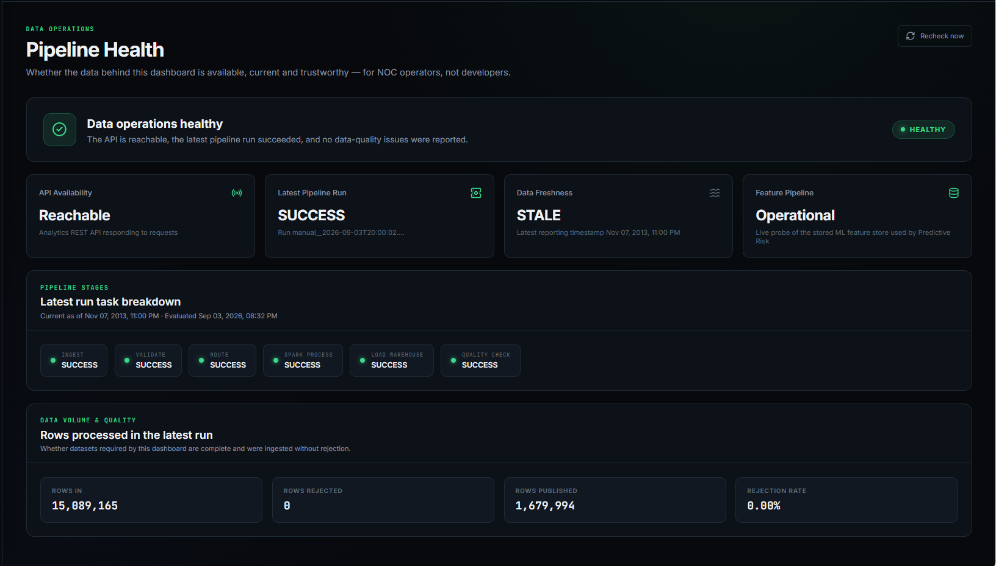
11 / PREDICTIVE + DATA OPERATIONS
12
Prediction is only useful when the evidence is healthy
Risk intelligence and pipeline health sit next to each other to make the operational context explicit.
Pipeline Health
Predictive Risk
ML output = future risk signal • Pipeline health = confidence in the evidence feeding the signal
NEXUS / TELECOM NETWORK ANALYTICS

Slide 13
13 / INVESTIGATION
13
From a signal to an evidence-backed decision
The added workflows connect the existing screens into one investigation experience.
ALERT INVESTIGATION
COMPARE MODE
What happened?
How different is it?
Alert
Grid
Baseline
Recent activity
Grid A
Grid B
Metrics
Pattern
HISTORICAL TREND
RISK → EVIDENCE
Is it persistent?
Why investigate?
Date A
Date B
Hourly trend
Context
Risk
ML inputs
Activity
Related context
These workflows reuse the same grid, activity, alert and risk evidence — they do not create parallel analytics logic.
NEXUS / TELECOM NETWORK ANALYTICS

Slide 14
14 / ENGINEERING
14
Technical implementation
A practical stack chosen for reproducibility, clear contracts and incremental delivery.
DATA
DISTRIBUTED
STORAGE
ORCHESTRATION
Python
CSV + GeoJSON
PySpark
ETL + enrichment
Parquet
Analytics warehouse
Airflow
Pipeline reliability
SERVICE
FRONTEND
ML
AI READY
FastAPI
REST contracts
React + Vite
Leaflet + Recharts
Scikit-learn
Decision Tree + baseline
Claude / MCP
Next integration
Engineering principle: compute once upstream, expose through contracts, reuse downstream.
NEXUS / TELECOM NETWORK ANALYTICS

Slide 15
15 / DEMONSTRATION
15
The end-to-end story for a customer
A concise path from network state to a prioritized operational action.
01
START
02
LOCATE
Open Overview
What is happening now?
Hotspots / Alerts
Where should I look?
03
DRILL
04
COMPARE
Grid Explorer
What does the grid show?
Historical / Compare
Is this unusual or persistent?
05
PREDICT
06
TRUST
Risk Intelligence
What may happen next?
Pipeline Health
Can I trust the evidence?
07
ACT
Investigation brief
What should I check next?
NEXUS / TELECOM NETWORK ANALYTICS

Slide 16
16 / NEXT PHASE
16
Claude as the NOC Copilot
The remaining integration layer should reason over evidence, not replace the analytics platform.
WHAT CLAUDE WILL RECEIVE
EXAMPLE NOC QUESTIONS
▸ Selected alert and grid context
▸ Current activity + baseline
▸ Historical / comparison evidence
▸ Predictive risk result + model version
▸ Pipeline / data health state
▸ Relevant tool and MCP outputs
“Explain this alert.”
“Why should I investigate this grid?”
“Is this condition persistent?”
“Compare this grid with another grid.”
“What evidence supports the risk signal?”
“What should I check next?”
Guardrail: Claude must state uncertainty and surface data-quality issues.
NEXUS / TELECOM NETWORK ANALYTICS

Slide 17
17 / CLOSE
17
What has been built
A working telecom analytics platform with an operational UI and a clear path to evidence-grounded AI.
DELIVERED
NEXT
▸ End-to-end data engineering pipeline
▸ PySpark processing and Milan spatial enrichment
▸ Analytics warehouse and reusable service contracts
▸ FastAPI network, feature, prediction and operational endpoints
▸ Professional React NOC dashboard
▸ Hotspot / alert spatial operations
▸ ML-based predictive risk + anomaly intelligence
▸ Historical, comparison and investigation workflows
▸ Pipeline/data operations visibility
Claude-powered
NOC investigation
Evidence-grounded reasoning across alerts, grids, risk and pipeline health.
TOOLS
MCP
AGENT
Goal: faster investigation with the same evidence and safety boundaries.
NEXUS / TELECOM NETWORK ANALYTICS

Slide 18
APPENDIX A
18
Representative API contracts
Useful for the technical discussion.
/network/summary
summary KPIs + as_of
/network/grid/{id}
hourly activity + reporting period
/network/alerts
alert records + severity + reason
/network/predict-risk
risk_score + risk_level + model_version
/pipeline/status
data/pipeline operational state
NEXUS / TELECOM NETWORK ANALYTICS

Slide 19
APPENDIX B
19
ML design at a glance
Simple, explainable features with a future-window target and time-aware validation.
FEATURES
OPERATIONAL GUARDRAILS
avg_activity
▸ Features describe history through time t.
▸ The target represents the next hourly interval.
▸ Chronological train/test split avoids temporal leakage.
▸ Base rate is reported alongside accuracy.
▸ Precision and recall are interpreted operationally.
▸ Model output is kept separate from narrative reasoning.
activity_growth
peak_ratio
variability
internet_share
trailing_median_24h
hour_of_day
day_of_week
NEXUS / TELECOM NETWORK ANALYTICS

